Slide 1
Technical Documentation on Lab 1 Reproduce (Deposit/Withdraw Ether)
Rizqy Eka Putra Rizaldy
School of Electrical Engineering
Department of Computer Engineering
1103184149

Slide 2
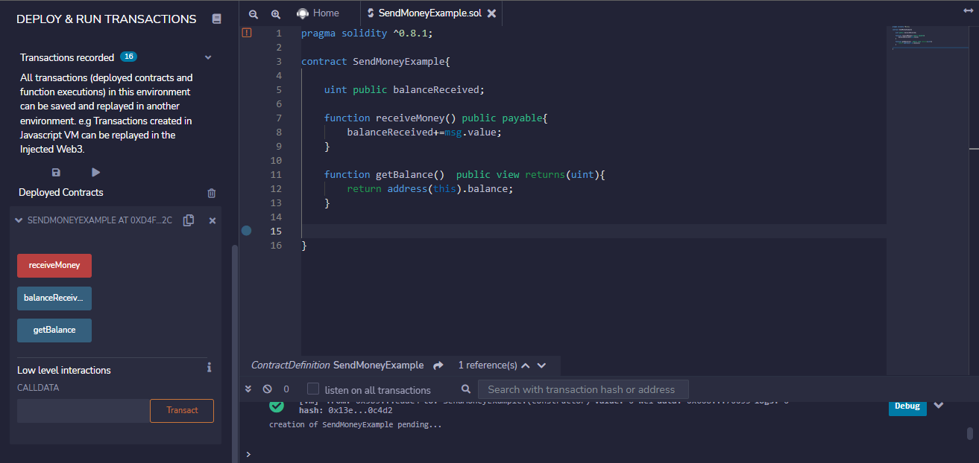
Create Initial Smart Contract with basic functionalities :

Slide 3
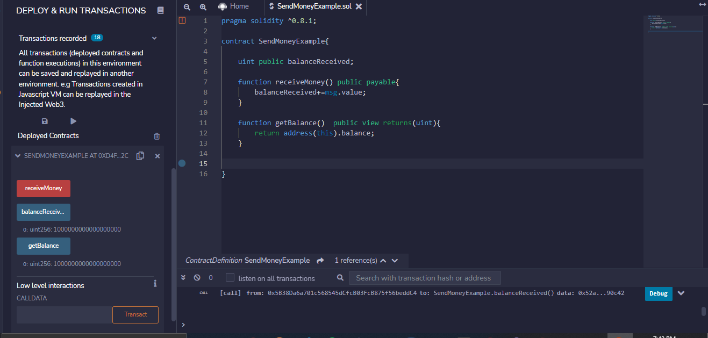
Test Deposit Ethereum

Slide 4
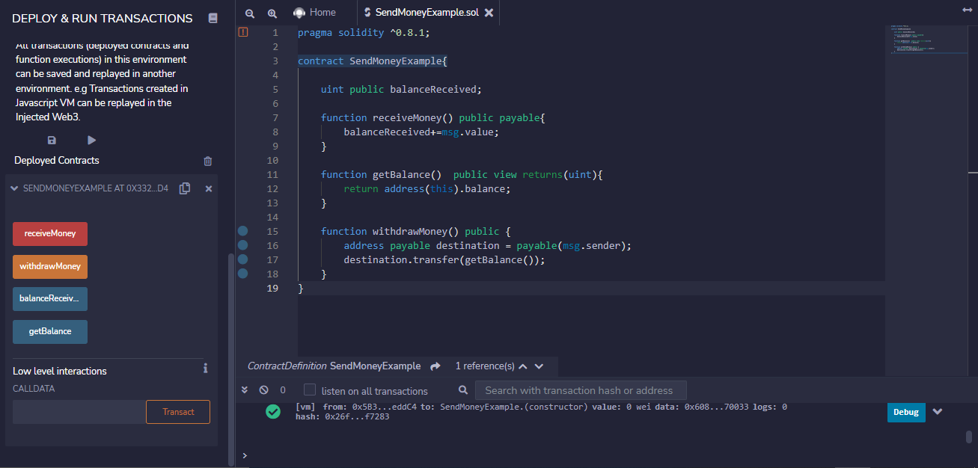
Add Withdraw Money Function

Slide 5
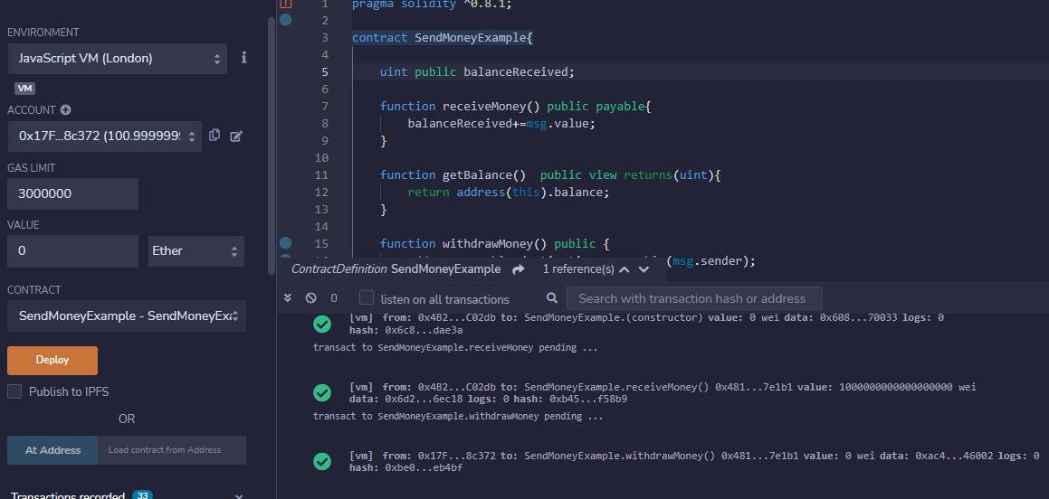
Balance Increased After Deposit

Slide 6
Lab Done
And that is the example of applying blockchain on a simple supply-chain application!

